Slide 1
Long-Term Financing
October 13th, 2022
Wenchen Wang

Slide 2
Last Week
Capital Budget Definitions
Depreciation
Time Value of Money (TVM)
Evaluating Capital Investments
Notes:
Definition: Capital asset; amortization/distribution of the capital cost is called depreciation expense; accumulated depreciation
Four methods of calculating depreciation expense: usage rate depreciation; straight line depreciation; accelerated depreciation: sum of the year digits depreciation (years of life left); double declining balance method (straight line depreciation rate and net book value)
TVM– interest expense: simple interest expense calculation(adding interest back to the principal at the end of the time period); compound interest expense calculation (adding interest back to the principal each year)
Evaluation: NPC (compare the cost and for the same time period); Annualized cost: using annualized cost formula to compare cost for two projects with different time periods); NPV (both inflow and outflow); IRR (calculate the interest rate when inflow = outflow); CBA (quantify benefits and costs and get a cost-benefit ratio)

Slide 3
Learning Objective
Equity Financing
Long-term Debt
Long-term Notes
Mortgages
Bonds
Leases

Slide 4
Long-term Financing
Used to pay for capital assets when capital costs exceed the cash available from operations or it would not be prudent to use operating cash flow for capital purposes.
Equity Financing—money raised that never has to be repaid.
Long-Term Debt--borrowed money with a maturity of more than 1 year (Short-term debt refers to borrowed money that must be repaid within 1 year).
Leases--contracts to make fixed payments in return for the right to use a capital asset.
Notes:
Obviously, equity financing has great advantages over debt. When money is borrowed, it places the organization at risk.

Slide 5
Equity Financing
Retained Earnings
Issuance of Stock: mostly for-profit organizations
Taxation: governments
Contributions
Notes:
When an organization earns a surplus or profit, that profit can be either retained within the organization or distributed to owners. Distributions made to owners of for-profit organizations are called dividends. Not-for-profit organizations do not have owners who are entitled to receive any of the profits that the organization earns. When profits are retained within the organization, regardless of whether it is a for-profit or not-for-profit organization, those profits can be used to finance capital assets such as buildings and equipment. A great advantage of using retained earnings is that there is no required repayment so there is less risk in using long-term financing from this source.
The investors who provide money to the company receive shares of stock in exchange for their investment. The stock represents an ownership interest in the organization. The stockholders have equity in the company. if the company does poorly, it is not obligated to pay those dividends.
Governments can raise long-term financing through taxation. If there is a desire to build a new courthouse, town hall, or school, the government can raise enough taxes in 1 year to provide the entire desired financing. That money can then be used immediately to pay for the new building or other capital acquisitions. However, it might not be realistic. It might be more equitable to borrow the money for the courthouse and to repay it over the years that the citizens will benefit from the courthouse. The repayments can come from taxes each year the courthouse is used. Very large public capital projects are often financed by debt.
Like the other equity financing approaches, a big advantage of donations is that they do not have to be repaid. If the organization can raise a large enough amount of charitable contributions, it can acquire the capital items it wants without having to incur debt. Many not-for-profit organizations solicit donations annually to support operating activities. Those donations are typically unrestricted and can be used for any reasonable purpose related to the organization’s mission. But not-for-profit organizations can also initiate capital campaigns to raise money specifically for capital acquisitions.

Slide 6
Long-term Debt
Long-Term Notes--unsecured loans.
Lender can ask for collateral
Mortgages--loans that are backed by a security interest
in land and/or buildings (collateral) that are owned by the borrower.
Bonds--standardized loan agreements between borrowers and lenders.
Notes:
It is referred to as long-term debt if it will be paid back more than 1 year into the future. In contrast with equity financing, debt financing represents money the organization borrows that must be repaid in the future, often with interest.
Long-term notes refer to when the organization borrows money and signs a note promising repayment. The note indicates the specific terms under which the money has been borrowed, such as the interest rate and timing of payments. Long-term notes are often unsecured loans. This means that the organization as a whole owes the money, but there is no one specific item that the organization pledges as collateral to ensure repayment. Thus, the lender is considered to be an unsecured creditor. If the organization has problems making repayments to its creditors, all the unsecured creditors share whatever resources are available to repay the organization’s various obligations. What would happen if the loan is not secured?
By contrast, a lender can ask for collateral. Collateral is a specific asset the lender can claim if the borrower fails to make principal repayments or interest payments when due. In general, the greater the likelihood that a borrower will not be able to repay a loan, the higher the interest rate the borrower pays unless it puts up adequate collateral.
Mortgages are loans secured by a specific asset. The asset is generally real estate. That is, land and buildings are used as collateral for the loan. Often, the funds are being borrowed to purchase the collateral.

Slide 7
Mortgage Payments
Mortgages call for equal periodic payments which repay the amount
borrowed and pay interest to the lender.
Mortgage payments are annuities, and they are the same for each time period
At the beginning, payments are mostly interest and near the end, they are mostly principal.
Loan Repayment
Mortgage Payment
Interest (Rent on loan)

Slide 8
Long-Term Loans
Year | Beginning Loan Balance (A) | Interest Accrued (B = A x 12%) | Total Payment in a Year (C) | Principal Repayment Portion (D = C – B) | Ending Loan Balance (E = A– D)
1 | $500,000 | $60,000 | $88,493 | $28,493 | $471,507
2 | $471,507 | $56,581 | $88,493 | $31,912 | $439,595
3 | $439,595 | $52,751 | $88,493 | $35,742 | $403,853
4 | $403,853 | $48,462 | $88,493 | $40,031 | $363,823
5 | $363,823 | $43,659 | $88,493 | $44,834 | $318,988
6 | $318,988 | $38,279 | $88,493 | $50,214 | $268,774
7 | $268,774 | $32,253 | $88,493 | $56,240 | $212,534
8 | $212,534 | $25,504 | $88,493 | $62,989 | $149,545
9 | $149,545 | $17,945 | $88,493 | $70,548 | $78,997
10 | $78,997 | $9,480 | $88,493 | $79,013 | ($16)
Notes:
Since each mortgage payment repays part of the loan + the interest, after the payment the organization owes the lender less money. Interest is rent on the money borrowed. As the amount of the loan outstanding declines, the required interest payment declines as well. Since the monthly mortgage payment is calculated as a constant annuity payment, the same each period, the repayment portion increases as the interest portion of the payment declines. As a result, early mortgage payments are mostly interest and just small repayments of the loan itself. By the tail end of the mortgage, each payment is mostly principal and only a small amount of interest.

Slide 9
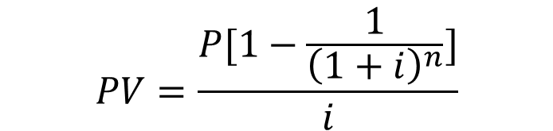

Annuities
Amount of money paid at equal time intervals in the same amount each time
$100 per week / $200 per month
P = Periodic Payment
i = Periodic Interest Rate
n = Total number of periods
PV = Present Value
FV = Future Value
$$PV=\frac{P[1−\frac{1}{{\left(1+ⅈ\right)}^{n}}]}{i}$$
$$FV=\frac{P[{\left(1+ⅈ\right)}^{n}−1]}{i}$$

Slide 10

Annuities Example
Assume you decide to invest $100 each month for 5 years. Calculate the present value and the future value after 5 years, considering the annual interest/discount rate of 2.5%.
$$PV=\frac{P[1−\frac{1}{{\left(1+ⅈ\right)}^{n}}]}{i}$$
$$FV=\frac{P[{\left(1+ⅈ\right)}^{n}−1]}{i}$$

Slide 11
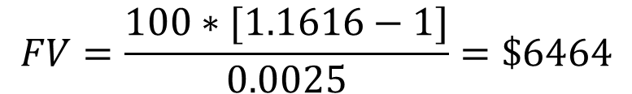
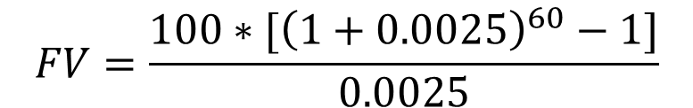
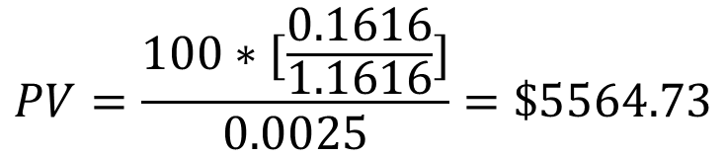
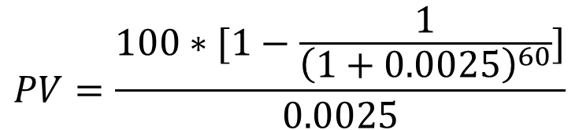
Annuities Example
Assume you decide to invest $100 each month for 5 years. Calculate the present value and the future value after 5 years, considering the annual interest/discount rate of 2.5%.
$$PV=\frac{P[1−\frac{1}{{\left(1+ⅈ\right)}^{n}}]}{i}$$
$$FV=\frac{P[{\left(1+ⅈ\right)}^{n}−1]}{i}$$
$$PV=\frac{100∗[1−\frac{1}{{\left(1+0.0025\right)}^{60}}]}{0.0025}$$
$$FV=\frac{100∗[{\left(1+0.0025\right)}^{60}−1]}{0.0025}$$
$$PV=\frac{100∗[\frac{0.1616}{1.1616}]}{0.0025}=\$5564.73$$
$$FV=\frac{100∗[1.1616−1]}{0.0025}=\$6464$$
Notes:
PV => (1+0.0025)^60 => [100/0.0025]*[1-(1/1.1616)] = 5564.73
FV => [100/0.0025]*[{(1+0.0025)^60}-1] = 6464

Slide 12
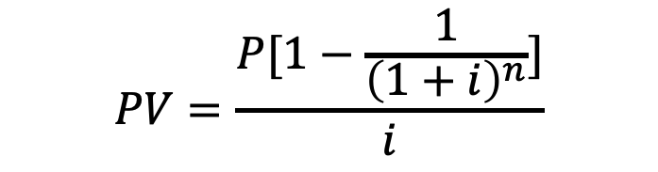
Annuities Example
Assume you took a loan of $500,000 for 10 years at an annual interest rate of 12%. Calculate the annual payments you need to make each year to pay off the loan in 10 years.
$$PV=\frac{P[1−\frac{1}{{\left(1+ⅈ\right)}^{n}}]}{i}$$

Slide 13
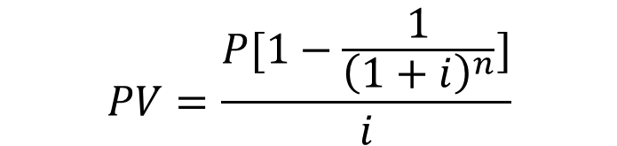
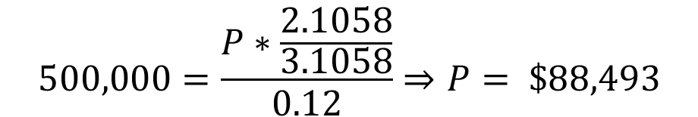
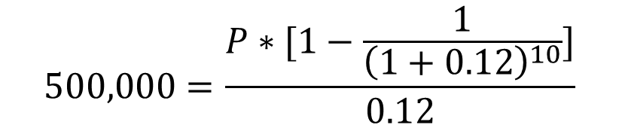
Annuities Example
Assume you took a loan of $500,000 for 10 years at an annual interest rate of 12%. Calculate the annual payments you need to make each year to pay off the loan in 10 years.
$$PV=\frac{P[1−\frac{1}{{\left(1+ⅈ\right)}^{n}}]}{i}$$
$$500,000=\frac{P∗[1−\frac{1}{{\left(1+0.12\right)}^{10}}]}{0.12}$$
$$500,000=\frac{P∗\frac{2.1058}{3.1058}}{0.12}⇒P= \$88,493$$

Slide 14
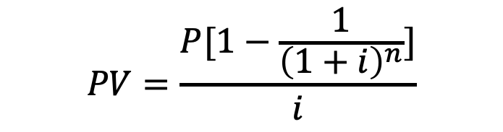
Calculating Mortgage Payments
Assume a 30-year, $500,000, 12% per year mortgage with monthly payments:
N = ?, i = ?, PV = $500,000, PMT = ?
0 1 … 359 360 1%
$500,000 PMT PMT PMT
$$PV=\frac{P[1−\frac{1}{{\left(1+ⅈ\right)}^{n}}]}{i}$$

Slide 15

Calculating Mortgage Payments
Assume a 30-year, $500,000, 12% per year mortgage with monthly payments:
N = 360, i = 1%, PV = $500,000:
$500,000=\frac{P(1−\frac{1}{{\left(1+0.01\right)}^{360}})}{0.12}$
$$P=61716.76$$
$$PMT=\frac{P}{12}=5143.06$$
$$Excel Formula=PMT\left(rate, nper, pv\left[fv\right]\right)$$
0 1 … 359 360 1%
$500,000 PMT PMT PMT

Slide 16
Bonds
Bond agreements specify:
the amount to be repaid, called the par, principal, stated, face, or maturity value of the bond;
the maturity date when the money must be repaid;
the rate of interest, called a coupon rate, which will be paid on the face value of the bond; and,
the time intervals at which the interest must be paid, usually every 6 months.
Why Bonds:
to spread risk
to disintermediate
to benefit from investor’s tax incentive to buy tax exempt bonds
Notes:
Bonds is the standardized payment agreements between the lenders and the borrowers.
When organizations borrow large amounts of money, they often issue (i.e., sell) a bond. Each individual investor in a bond lends a portion of the total amount to the organization in exchange for the organization’s promise to repay the loan. That promise is evidenced by a formal document called a bond.
Why bonds:
First, if one lender were to lend a very large amount of money to one borrower, it would be taking a tremendous risk. Lenders would prefer to lend smaller amounts to a larger number of borrowers.
Second, banks lend other people’s money. People put money in bank accounts, and the bank lends the money to borrowers. The bank acts as an intermediary between the individual and the borrower. If the borrower can eliminate the intermediary (disintermediate), it can save that cost. (Cutting the bank out of the lending process).
Third, the interest on some bonds is exempt from income taxes. This provides investors an incentive to buy such bonds.

Slide 17
Bonds
Sale Proceeds
Primary Market
Issuer
Buyer
Bonds
Interest and Principal Payments
Fair Market Value of Bonds
Secondary Market
Buyer
Seller
Bonds
Notes:
When bonds are initially issued, money is lent to the borrower in what is called the primary market. In primary-market transactions, borrowers issue the bonds and receive the proceeds of the bond issue directly or through a broker. In return, borrowers promise to make all interest payments and principal repayments when they are due throughout the life of the bond.
Bond obligations are generally transferable. After a bondholder lends money to an organization, the bondholder can wait until the maturity date to get the money back or sell the bond in what is called the secondary market. In secondary-market transactions, the owner of the bond sells it to a new investor and is paid the market value of the bond at the time of that sale. The original issuer is not involved in secondary-market transactions. The issuer’s only obligation is to pay the new owners the required amounts of principal and interest when they are due.

Slide 18
Bonds
Bonds are an example of mixed cash flows. Here is the timeline for a 10-year, $1,000,000 face value bond that bears an interest rate of 10% per annum and pays interest every 6 months.
0 1 19 20
5%
0 $50,000 $50,000 $50,000
$1,000,000 Principal
Annuity
Single Payment
Notes:
In this case, this bond would make a payment of $50,000 every 6 months until the maturity date.

Slide 19
Bonds
Normally, bonds can be sold by their owners. But, interest rates fluctuate on a daily basis.
Since the cash flows from bonds are fixed, bond prices vary with changes in interest rates.
The general rule: bonds are worth the present value of the stream of cash flows that they generate discounted at the prevailing market rate of interest.
Notes:
For example, consider a 20-year, 10 percent bond. What if the bond is about to be issued, but interest rates rise in the general economy? No one will be willing to lend money to get 10 percent if they can get 12 percent elsewhere. The organization must offer to sell the bonds at a discount. (If interest rates have instead decreased, then the organization will be able to charge a premium for the bond.)

Slide 20
Bonds Example
Example: Suppose that we own a $1,000,000, 10%, 10-year semiannual bond and want to sell it in a market where interest rates have risen to 12%. What will the bond be worth?
The cash flows are unchanged! To value the bond, we only change the interest rate used in the PV calculations to reflect the prevailing market rate!
0 1 19 20
6%
0 $50,000 $50,000 $50,000
$1,000,000 Principal
Annuity
Single Payment
Notes:
If we know the current interest rate in the marketplace, the number of compounding periods, and the future interest payments and principal repayments, we can find the PV of the bond—that is, we can find its market value.

Slide 21
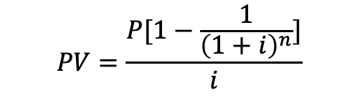
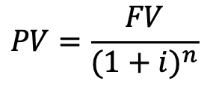
Bonds Calculations
First, calculate the PV of the $50,000 annuity using the 12% market interest rate.
N = 20, i = 6%, PMT = $50,000, PV = ?
PV = $573,496
Second, calculate the PV of the $1,000,000 principal repayment.
N = 20, i = 6%, FV = $1,000,000, PV = ?
PV = $311,805
Then, add the two PVs to get the value of the bond.
Value of Bond = $573,496 + $311,805 = $885,301
Note: Excel and some calculators can do this as one calculation.
Enter N, i, FV, and PMT. Solve for PV.
=PV(rate, nper, pmt, fv) =PV(6%, 20, 50000, 1000000)
$$PV=\frac{P[1−\frac{1}{{\left(1+ⅈ\right)}^{n}}]}{i}$$
$$PV=\frac{FV}{{(1+i)}^{n}}$$
Notes:
What if we use the i = 5%?

Slide 22
Leases
Types of leases
Operating Leases: All short-term or cancelable leases
Capital Leases: Some long-term and non-cancelable leases
Possible advantages of leasing
flexibility and protection against obsolescence
lower costs from pass-throughs of interest
equipment cost and tax-related savings
Possible disadvantages of leasing
tendency toward higher costs
Lease payments are made at the beginning of the month before we use the asset.
Notes:
Sometimes, rather than buying a capital asset and financing the purchase with direct borrowing from a bank or by issuing a bond, organizations lease capital assets. In the case of long-term, noncancellable contracts to lease buildings or equipment, the organization has made a long-term commitment to make payments in the future. This commitment is treated as a form of long-term financing, and the lease is referred to as a capital lease.
Advantages:
Flexibility: The term of the lease can be set for limited periods. If we expect to need a piece of equipment for only half of its useful life, we will not have to get involved with selling it as we would if we purchased the item. Also, leasing protects us if we are afraid that the equipment may become obsolete
Another factor is related to the leasing company’s market power. A large leasing company may be able to purchase equipment at larger discounts than are available to a single buyer and borrow money at a lower interest rate than a small organization. The leasing company may share some of those savings with the organization leasing the asset.
Sometimes it is possible that a for-profit organization can save taxes by purchasing certain items. It can then pass some of that tax savings on to the not-for-profit organization in the form of lower lease payments.
Disadvantage:
Leasing does tend to be more expensive than purchasing assets. In contrast with the use of bonds to disintermediate, or remove an intermediary, leasing adds another intermediary—the leasing company. Therefore, there is one extra layer of profit making. This tends to drive the cost up.
A common difference between lease payments and mortgage payments is that often lease payments are made at the beginning of the month before we use the asset, while mortgage payments typically come at the end of each month after we have used the asset.

Slide 23

Leases Example
Suppose that an organization agrees to lease a piece of equipment for $1,000 per year for 10 years. Assume that this lease calls for payments at the end of each year of use. Also assume that there is an implicit interest rate of 12 percent built into the lease and we treat this as a long-term obligation. How much do we owe?
$Excel Formula=PV\left(rate, nper, pmt\right)$
0 1 … 9 10 12%
PV $1,000 $1,000 $1,000

Slide 24

Leases Example
Suppose that an organization agrees to lease a piece of equipment for $1,000 per year for 10 years. Assume that this lease calls for payments at the beginning of each year of use. Also assume that there is an implicit interest rate of 12 percent built into the lease and we treat this as a long-term obligation. How much do we owe?
$Excel Formula=PV\left(rate, nper, pmt,type\right)$
-1 0 … 8 9 12%
PV $1,000 $1,000 $1,000
Notes:
Leases often require payments to be made at the beginning of each time period instead of at the end. In the above example, suppose that the 10 payments of $1,000 had to be made at the start of the year rather than at the end. The PV of the lease would not be the same, because each of the payments is occurring 1 year sooner. When equal payments are made at the end of each period, they are referred to as an annuity in arrears or an ordinary annuity. When equal payments are made at the beginning of each period they are referred to as an annuity in advance.

